Slide 1



State Feedback Control and Observer Design for a 2 DOF Robotic Arm
IE415 Control Of Autonomous System
Prof. Sujay Kadam
Jal Dani 202201315
01

Slide 2
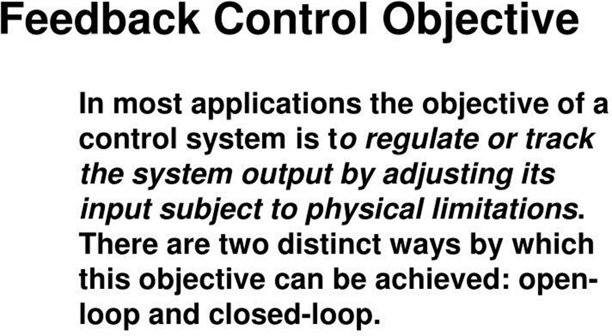
02

Slide 3
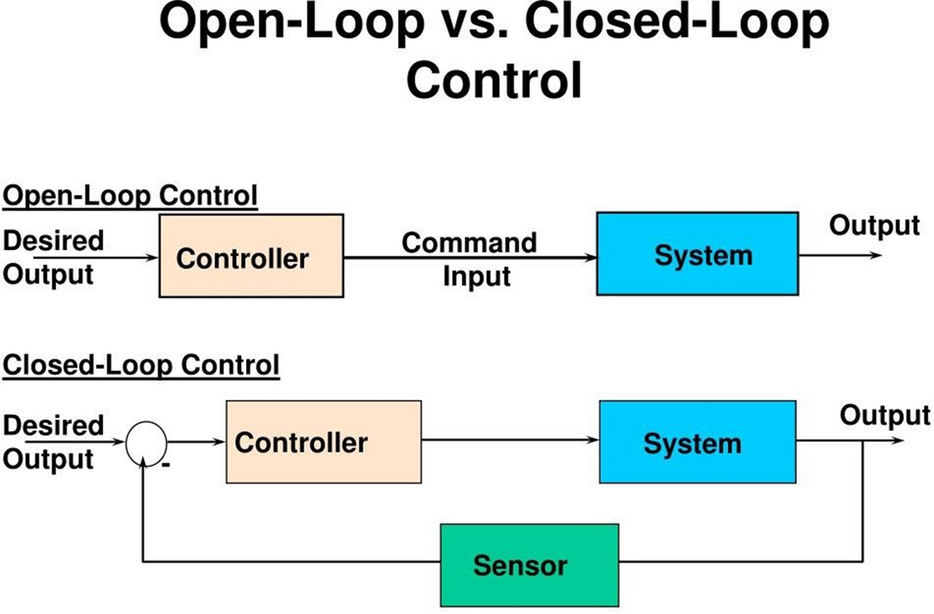
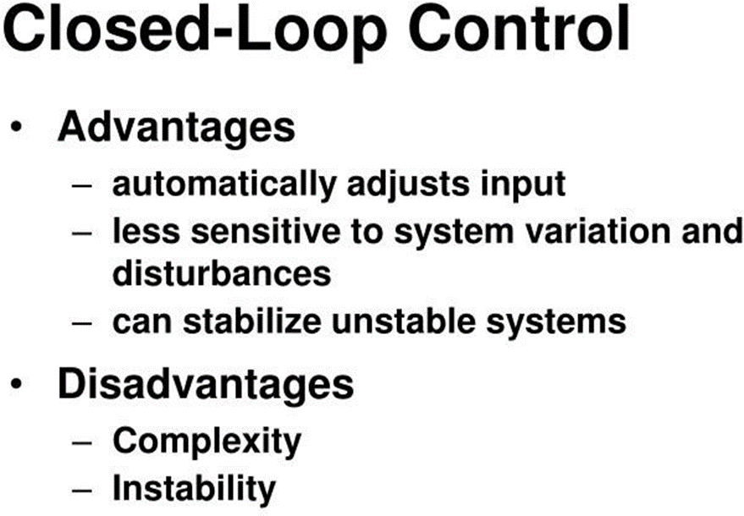
03

Slide 4
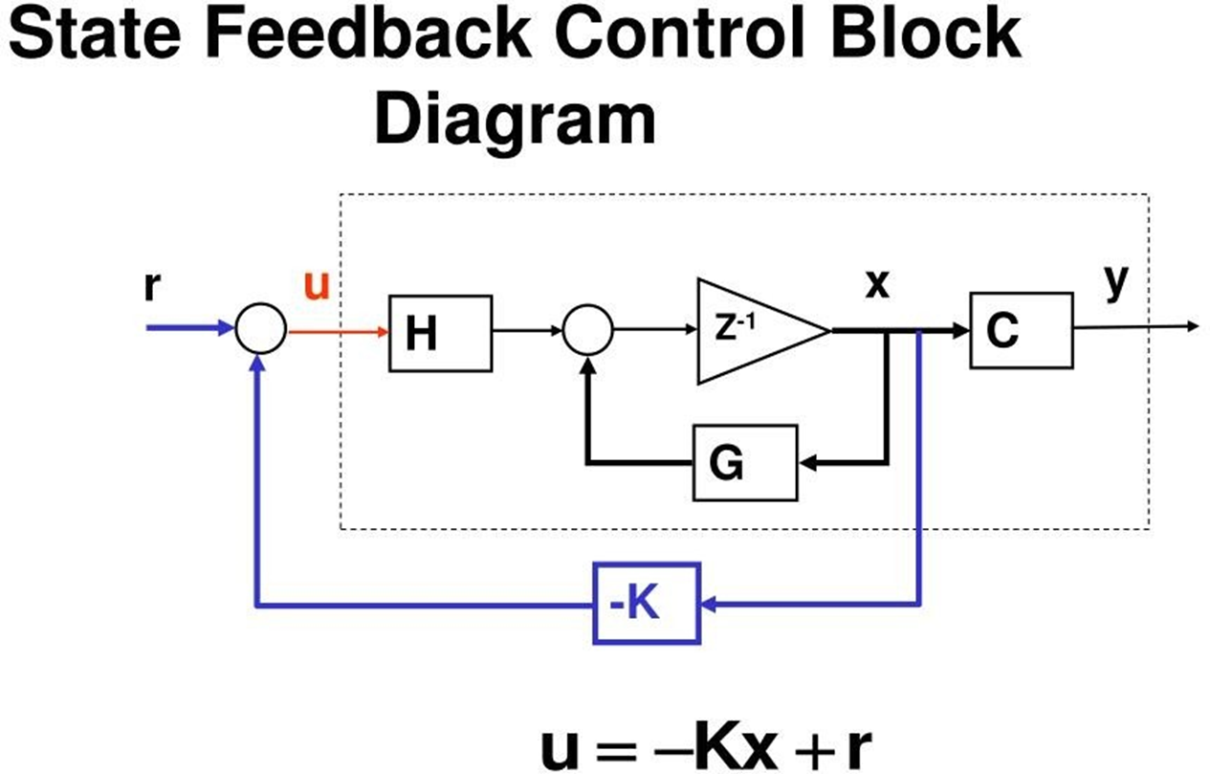
04

Slide 5
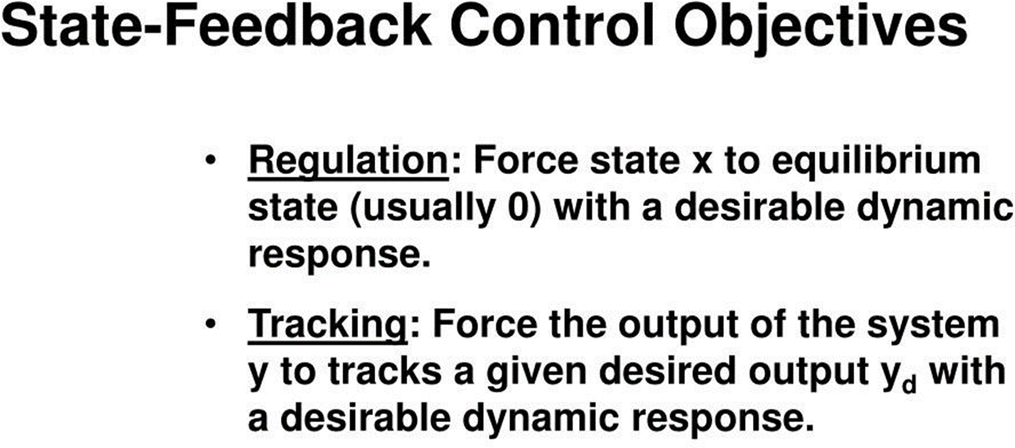
05

Slide 6
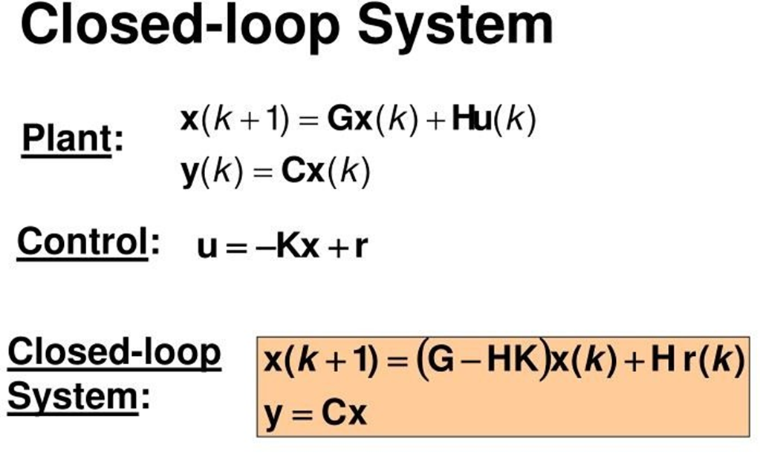
06

Slide 7
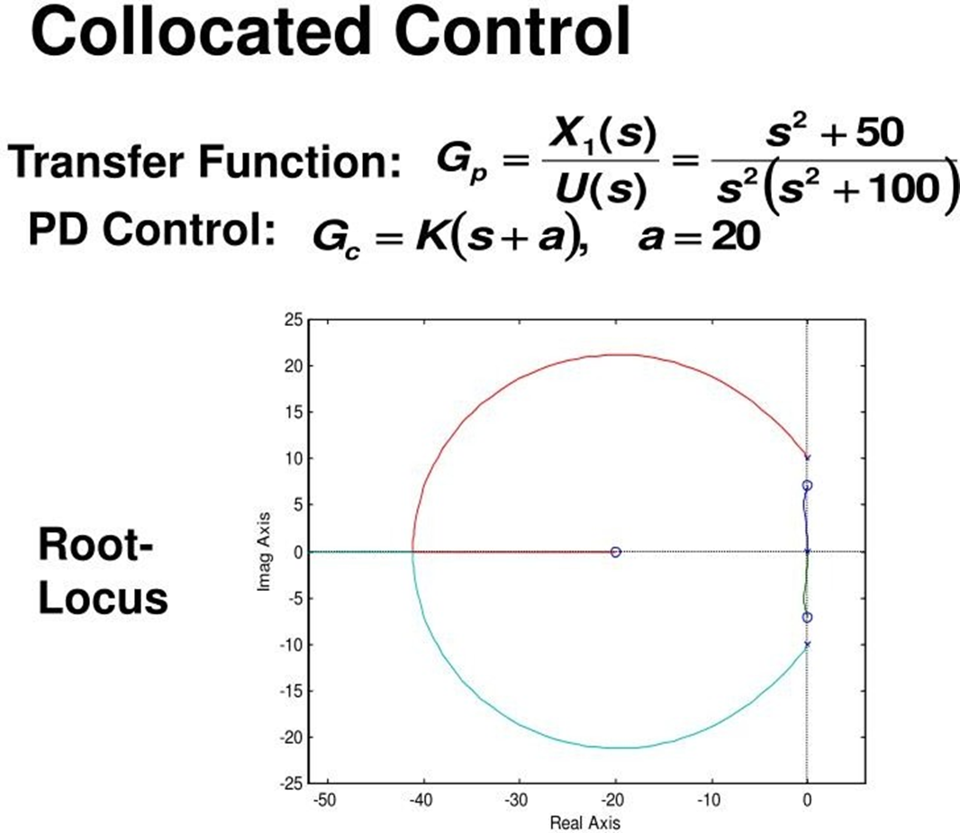
07

Slide 8
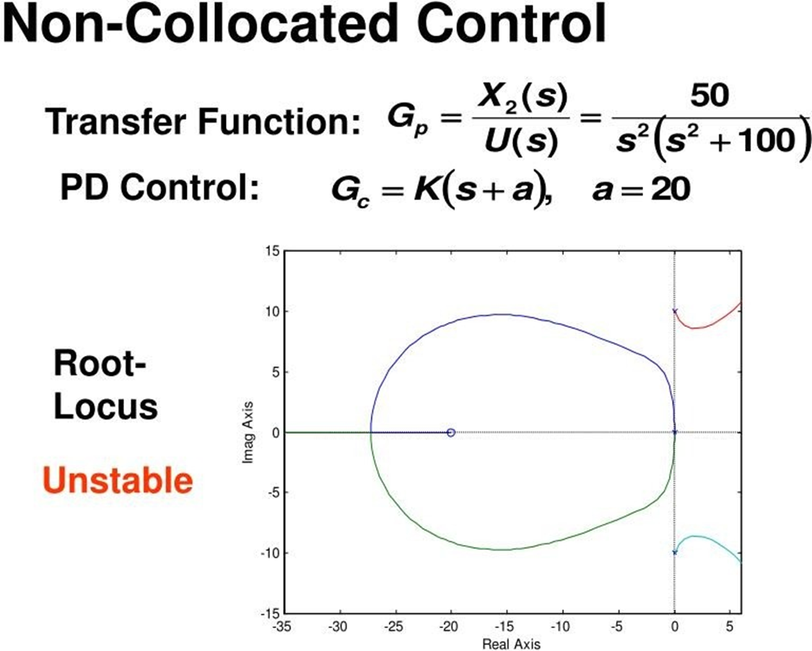
08

Slide 9
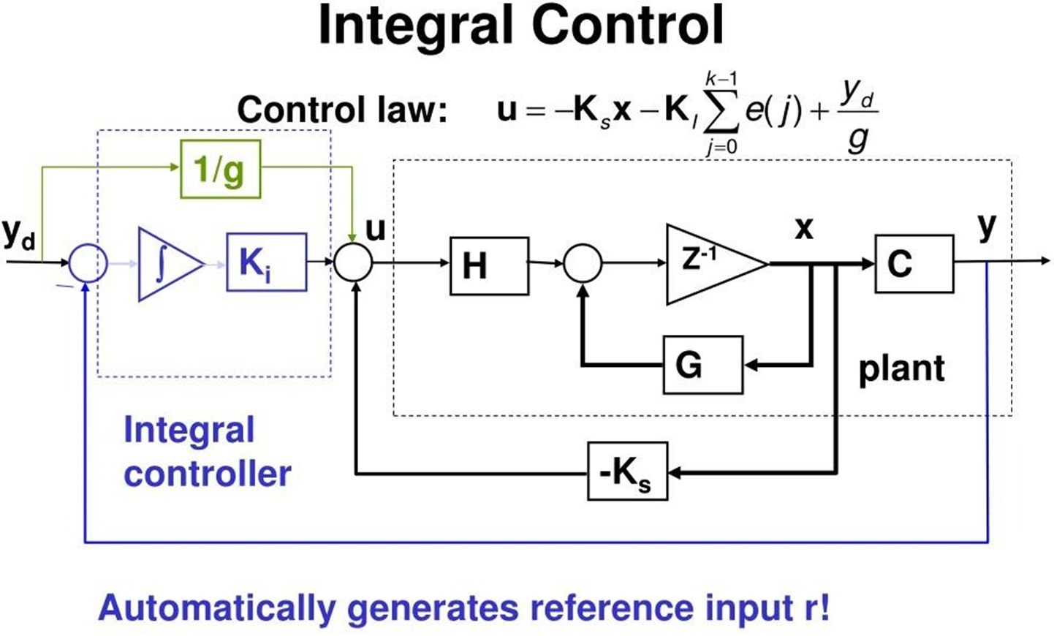
09

Slide 10
Degree Of Freedom (DOF)
(a) Degree of freedom of a point in space:
➤ Degree of freedom (DOF) of a point is the number of indeoendent coordinates required to define the position and orientation of a point.
➤ Thus a point in space has only three degrees of freedom or three coordinates are required to define its position. The point P can be uniquely defined by specifying its three co-ordinates x, y and z.
(b) Degree of freedom (DOF) of a rigid body :
➤ Consider a rigid body moving in space as shown in Fig. 1.34. This rigid body have possesses following independent motion.
1) Translation motions along any three perpendicular axis x, y and z.
10

Slide 11
2) Three rotational motions about the axis x, y and z. Thus degree of freedom of rigid body have six degree of freedom in free space.
(c) Degree of freedom (DOF) of a mechanism :
➤ A mechanism can also have several degree of freedom (DOF).
> The degree of freedom (DOF) of a mechanism is decided by
the degree of freedom (DOF) of the links constituting that mechanism. Accordingly, we can classify mechanism under two general categories as follows:
1) Spatial mechanism.
2) Planner mechanism.
11

Slide 12
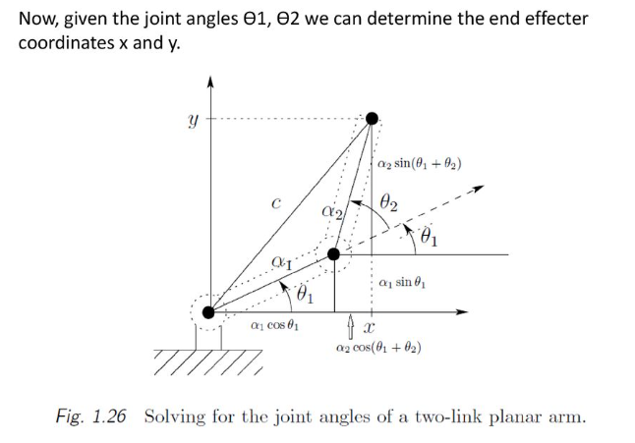
2 DOF Manipulator
12

Slide 13
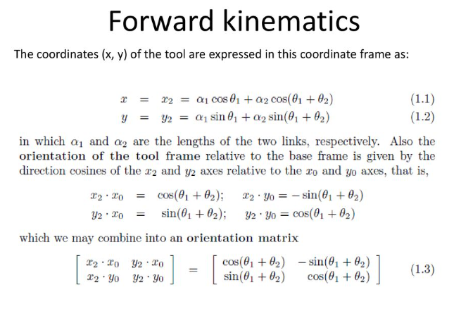
13

Slide 14
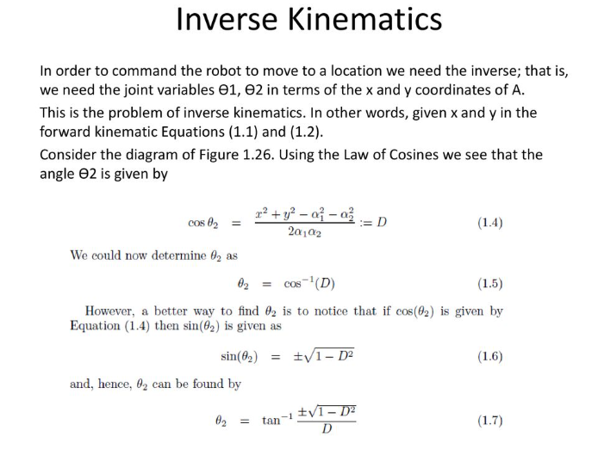
14

Slide 15
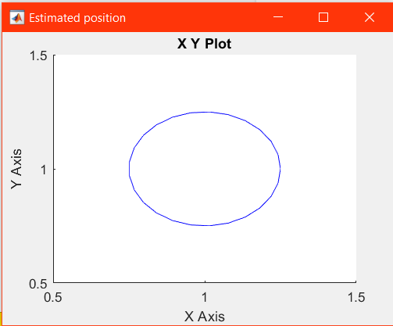
Robo arm 2D Trajectory
15

Slide 16
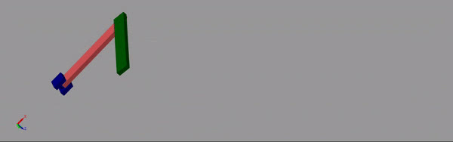
Robo arm Simulink Result
16

Slide 17
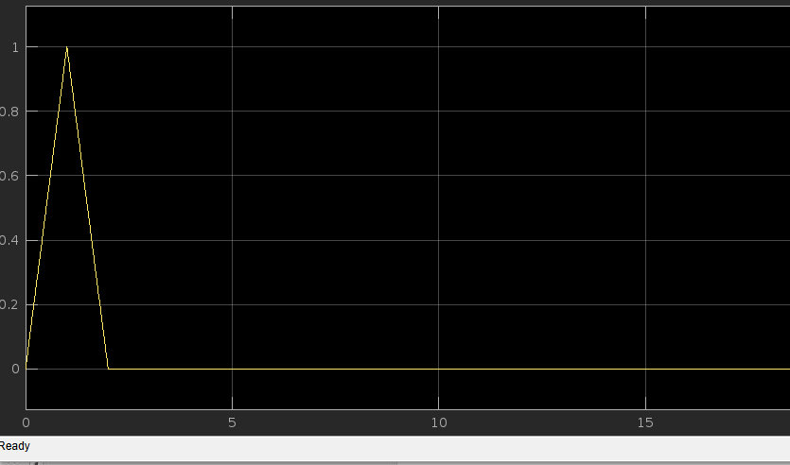
2 DOF Simscape Matlab Results
This shows a signal that spikes initially and then settles to zero, which represent an impulse response or a damped system reaching equilibrium (possibly acceleration or force on one DOF).
17

Slide 18
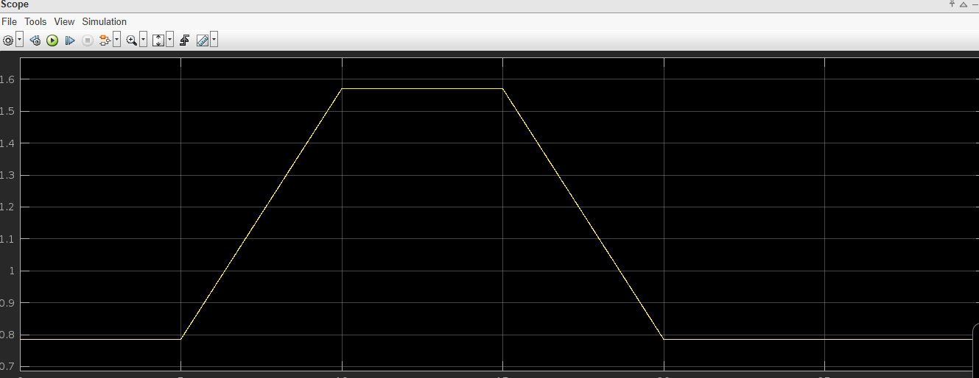
2 DOF Simscape Matlab Results
This graph shows a single signal rising, holding a plateau, and then decreasing symmetrically, which is characteristic of a displacement or position signal that follows a trajectory over time.
18

Slide 19
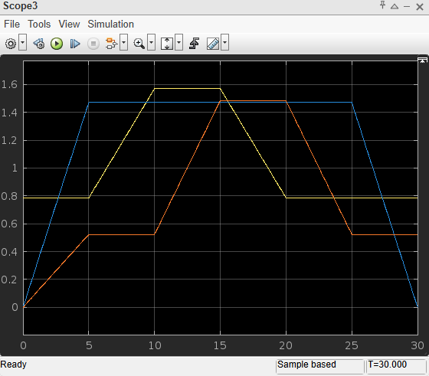
2 DOF Simscape Matlab Results
19

Slide 20
Thank You
20

